Slide 1
Frequency Stabilization of a Diode Laser to the RB D2 Transition
Charlotte Zehnder, Will Bodron, Wolfgang Korsch

Slide 2
Why is Frequency Stabilization Needed?
Nuclear phys background

Slide 3
Why is Frequency Stabilization Needed?
Laser Drift
Mirror
Laser Diode
Lens

Slide 11
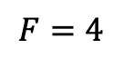
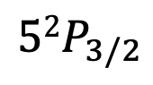
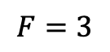
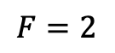
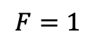
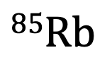
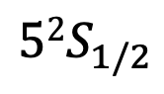
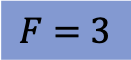
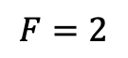
384230. 406 GHz

Slide 12



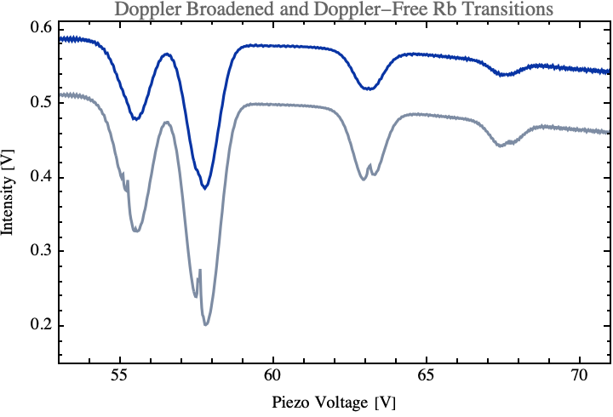
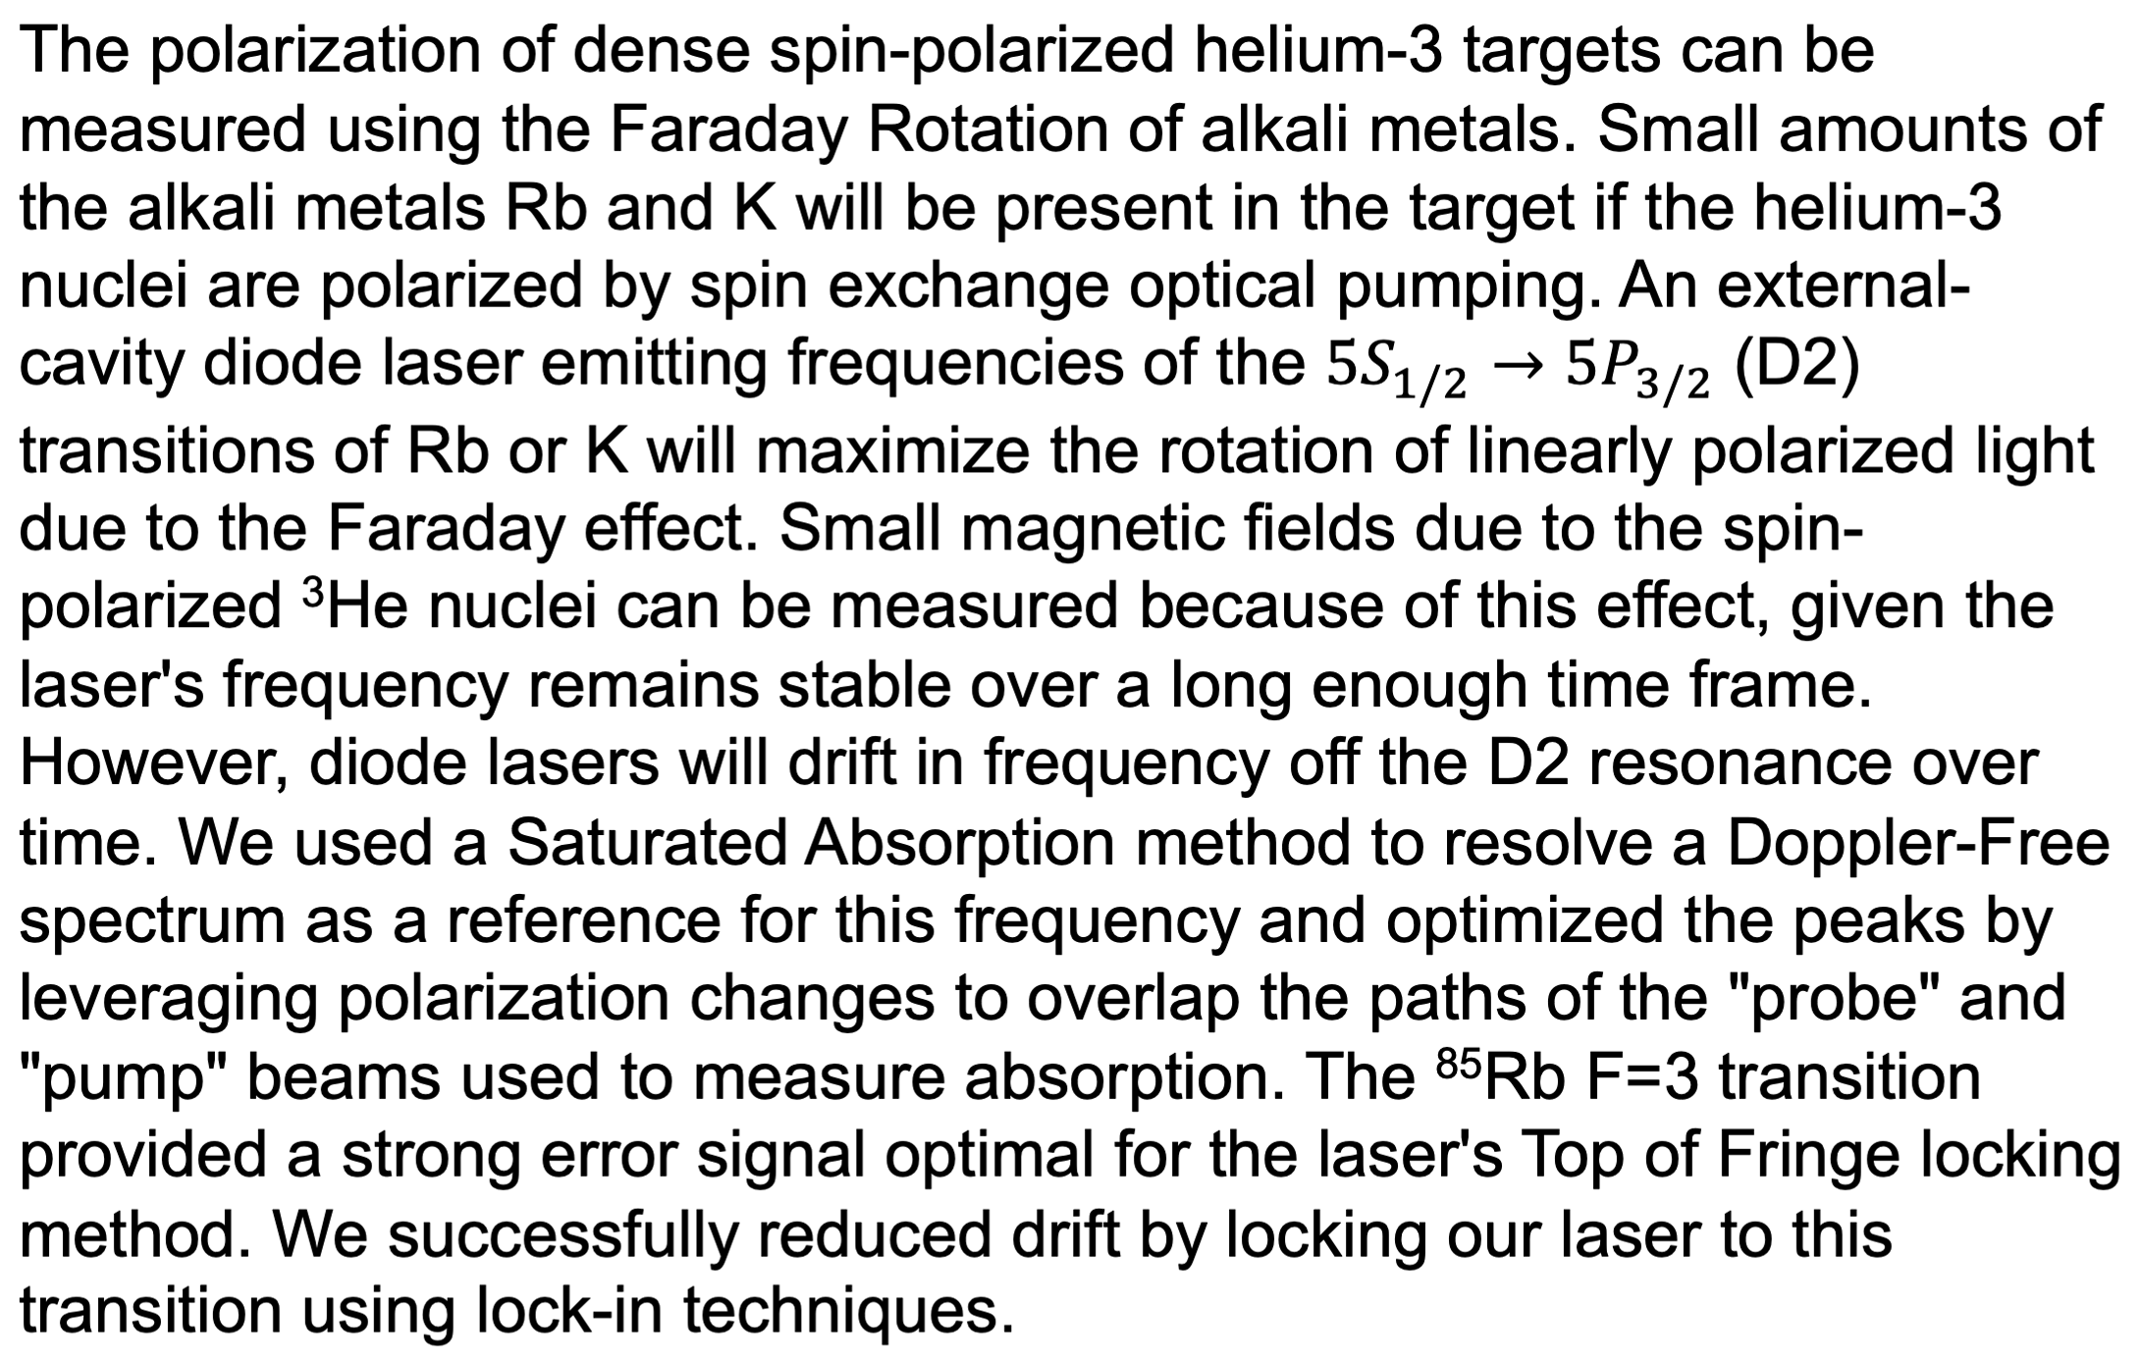
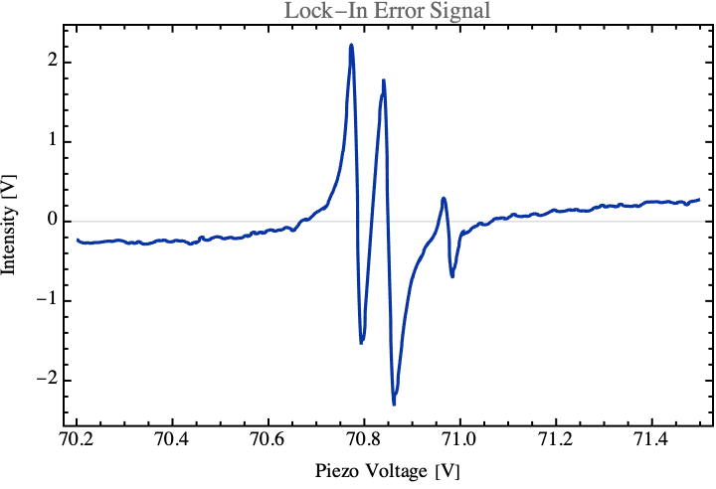
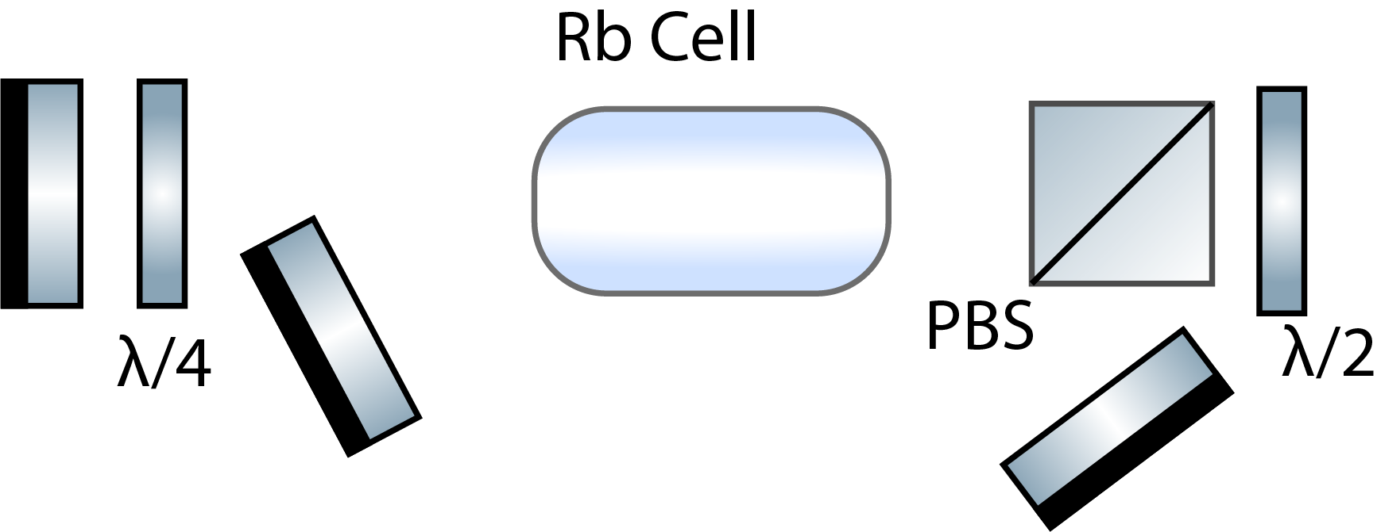
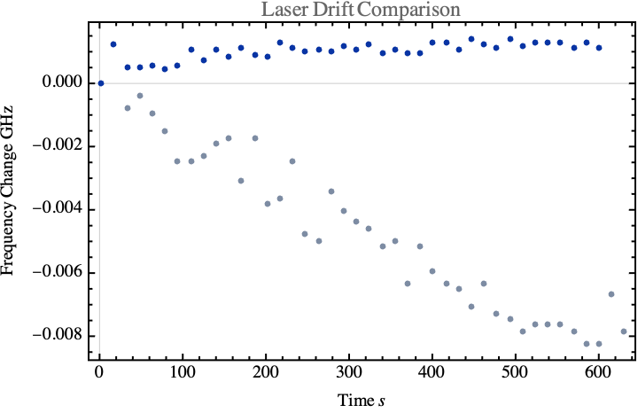
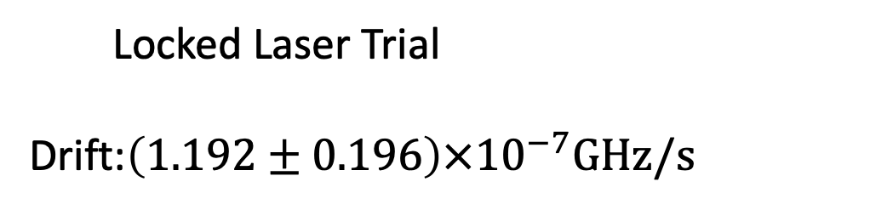
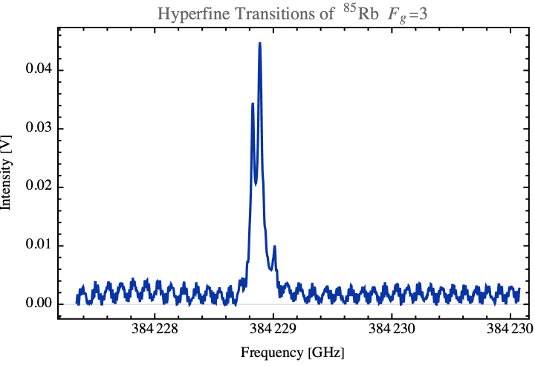
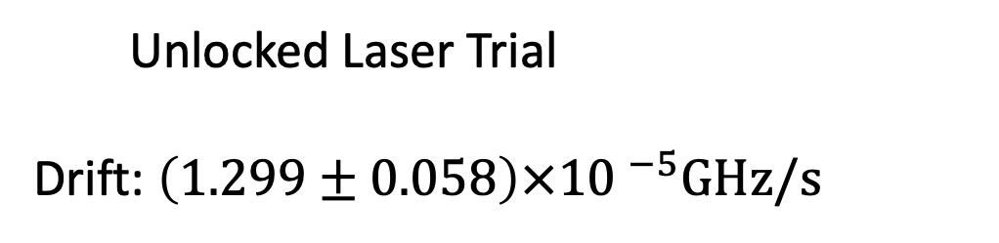
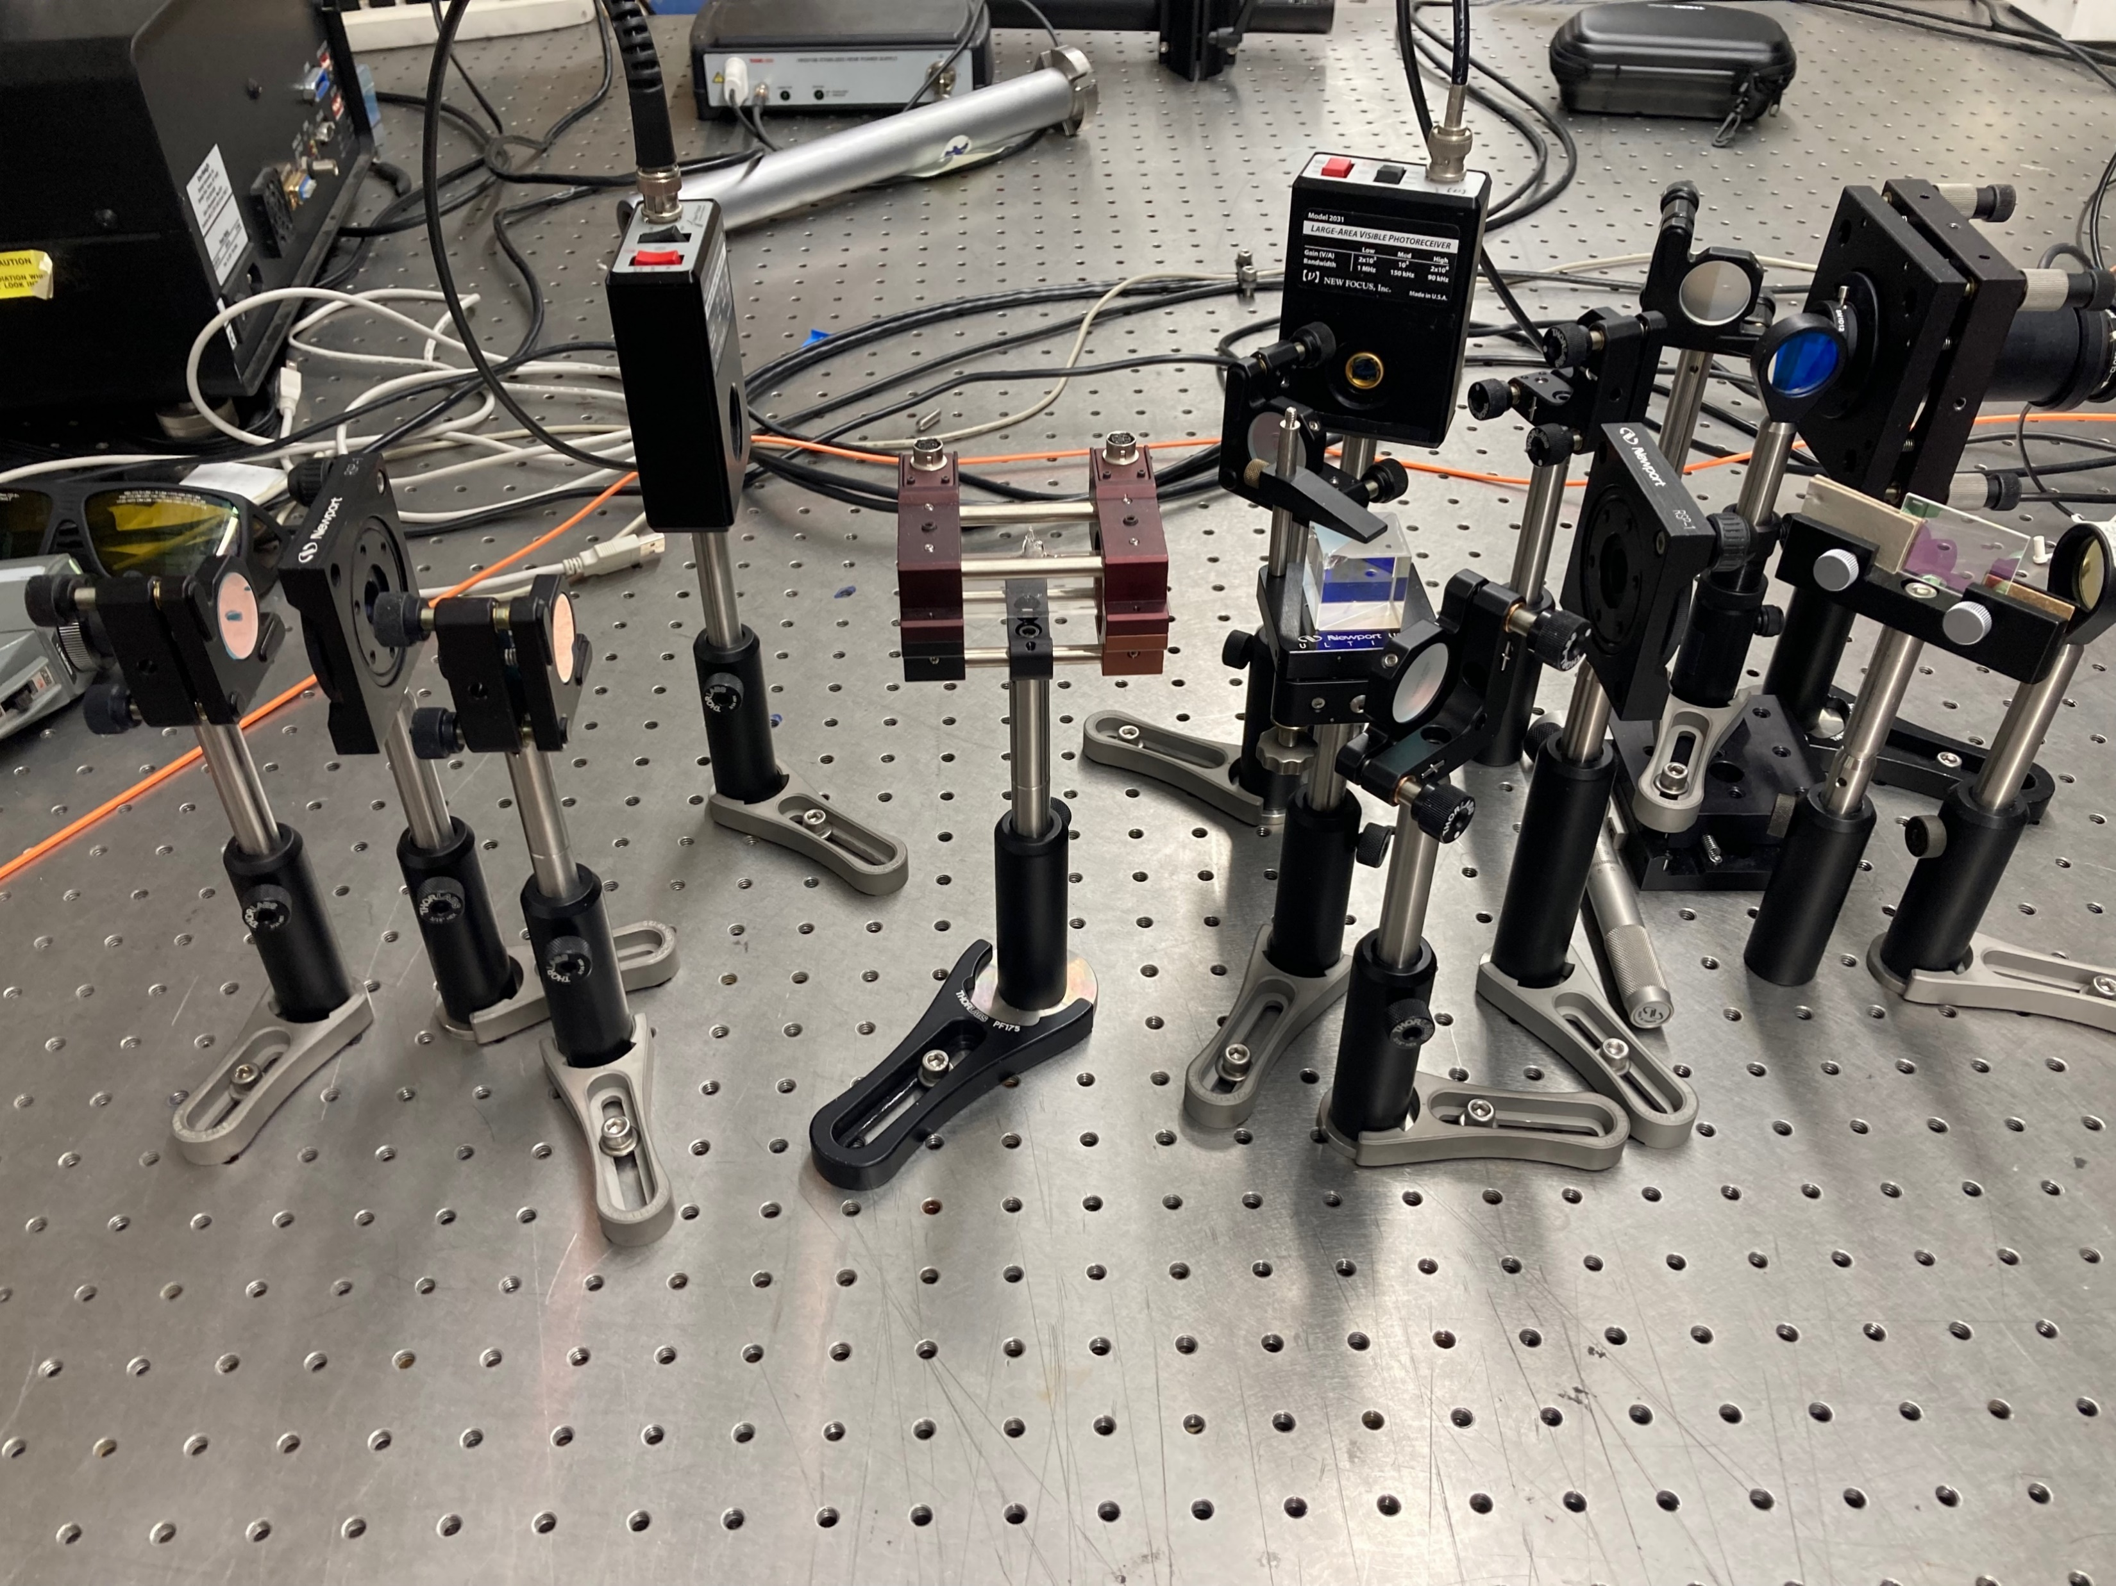
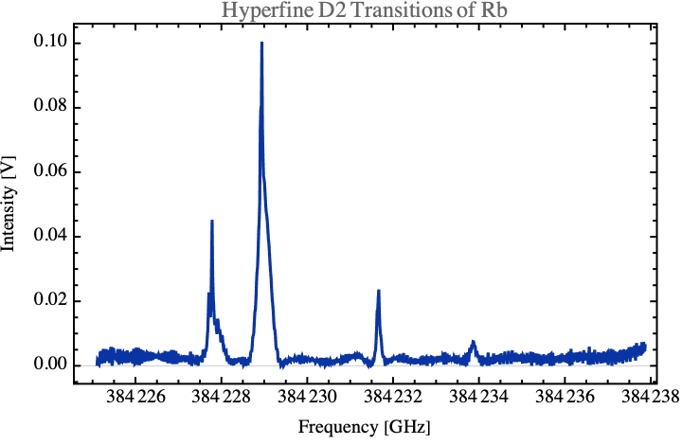
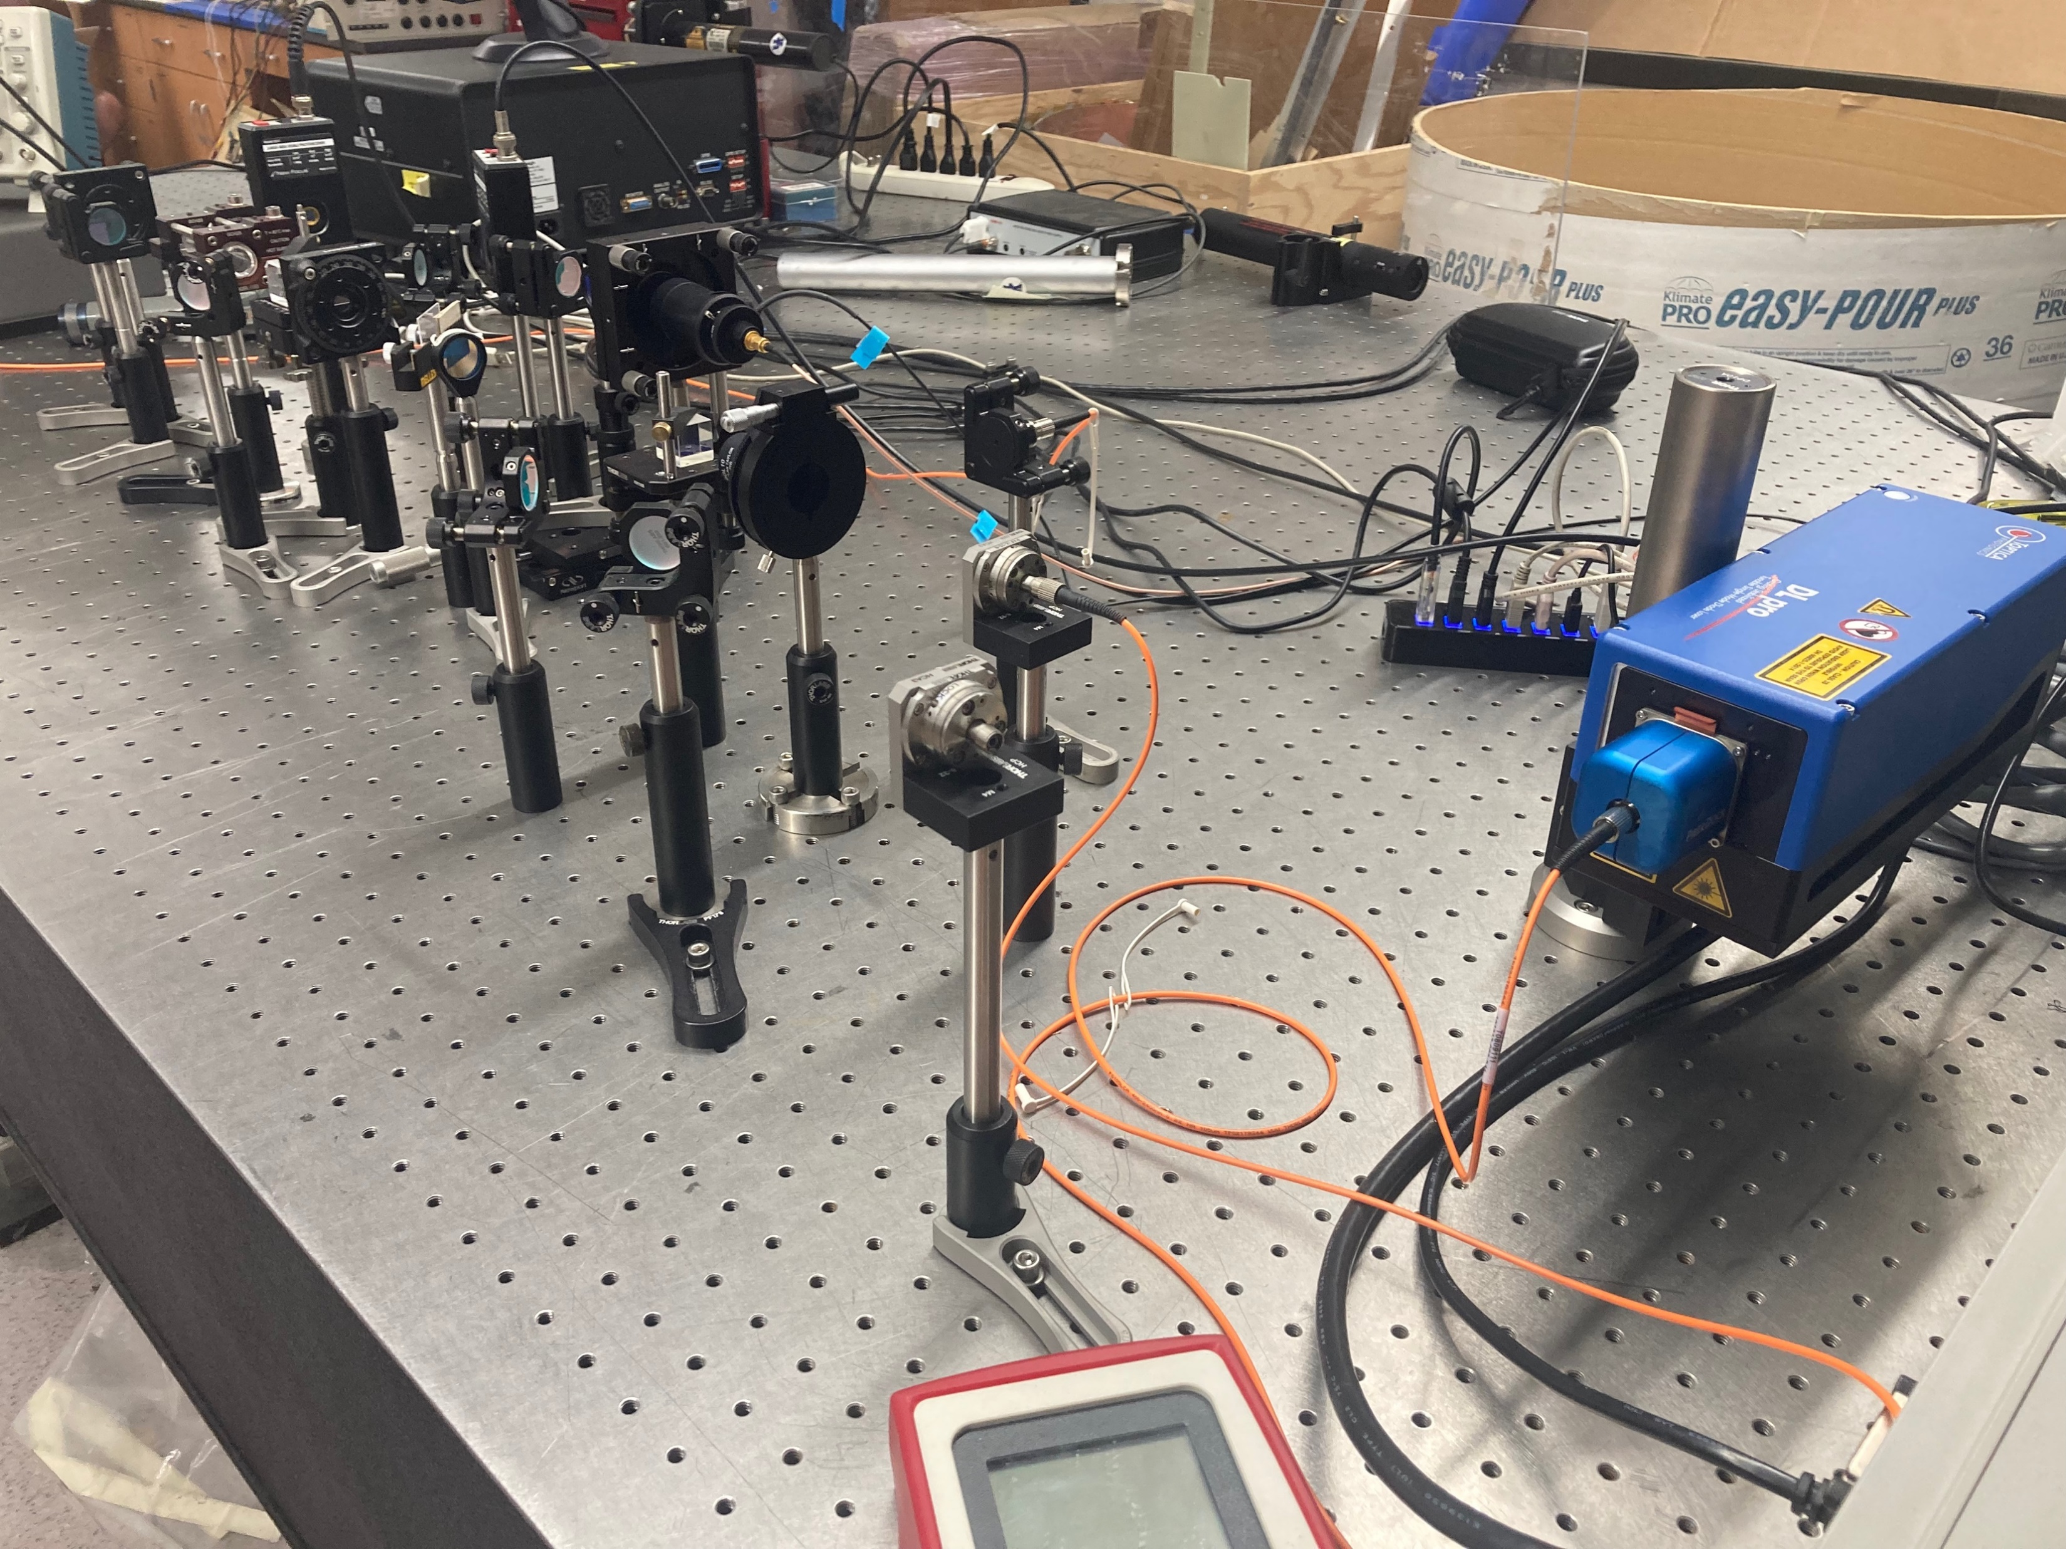
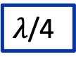
Frequency Stabilization of a Diode Laser to the Rb D2 Transition
Charlotte Zehnder¹, Will Bodron²
Department of Physics, University of Kentucky
Research Mentors: Dr. Wolfgang Korsch
¹Middlebury College, VT
²University of Kentucky, KY
Abstract
Top of Fringe Locking
We used the doppler-free peaks of ⁸⁵Rb F_{g}=3 as a reference for our laser lock. Our infrared laser controller, the Toptica DLC Pro, uses frequency modulation and demodulation to produce an error signal proportional to the figure seen right. Frequency modulation is achieved through control of the laser current and piezo voltage. We adjusted the modulation frequency, amplitude, and phase to obtain a clean signal. The error signal served as input for the PID responsible for locking the laser.
Polarized light
Laser Stabilization
Results
The frequency produced by diode lasers will drift over time due to environmental changes such as vibrations or temperature and humidity fluctuations. We improve the long-term frequency stability by adjusting the laser piezo voltage and current to correct for these changes.
Mirror
Saturated Absorption
Laser Diode
Lens
Diffraction Grating
External Cavity Diode Lasers provide extra stability using a diffraction grating which reflects the desired mode into the laser as feedback. Changing the angle of the diffraction grating will change the frequency of the laser.
384230. 406 GHz
We monitored the frequency drift of the locked vs. unlocked laser using a scanning Fabry-Perot interferometer. After creating a frequency stabilization system using the Doppler-free transition of ⁸⁵Rb as the frequency reference, we improved the laser stability by over a factor of 10.
Optical Set-Up
Photodetectors
Mirror
Acknowledgements
This material is based upon work supported by the U.S. National Science Foundation under Award Number PHY-1950795 (UK REU) and the U.S. Department of Energy, Office of Science, Office of Nuclear Physics, under Award Number DE-FG02-99ER41101."
Rb Cell
Polarizing Beam Splitter

Slide 13
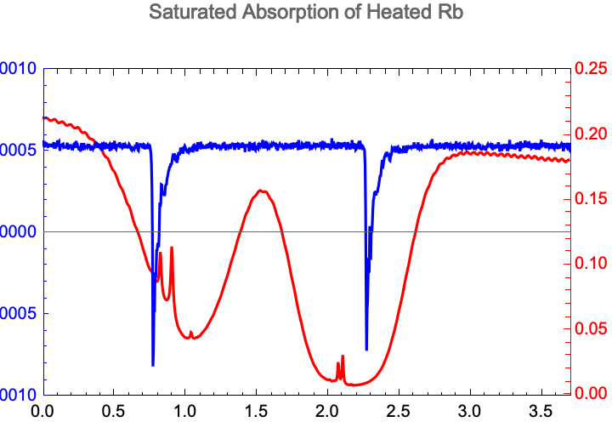
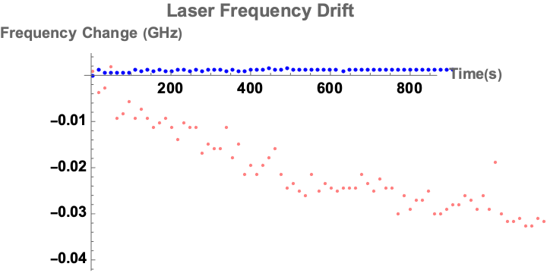
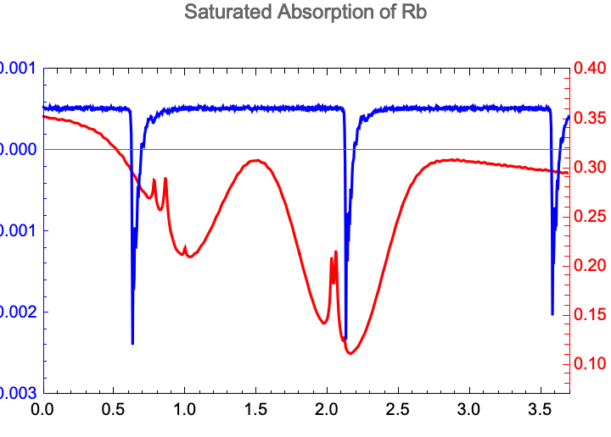
Week of July 30th
Ran laser drift trials to test laser lock
Collected data on the Doppler-broadening of heated Rb cell
Next Goal: Add a reference beam to isolate Doppler-free peaks
Frequency Change (GHz)
Frequency Change (GHz)
C. Zehnder

Slide 14
Week of July 30th
Ran laser drift trials to test laser lock
Collected data on the Doppler-broadening of heated Rb cell
Next Goal: Add a reference beam to isolate Doppler-free peaks
Frequency Change (GHz)
Frequency Change (GHz)
C. Zehnder

Slide 15
Frequency Stabilization of a Diode Laser to the Rb D2 Transition
Charlotte Zehnder¹, Will Bodron²
Department of Physics, University of Kentucky
Research Mentors: Dr. Wolfgang Korsch
¹Middlebury College, VT
²University of Kentucky, KY
Abstract
Top of Fringe Locking
We used the doppler-free peaks of ⁸⁵Rb F_{g}=3 as a reference for our laser lock. Our infrared laser controller, the Toptica DLC Pro, uses frequency modulation and demodulation to produce an error signal proportional to the figure seen right. Frequency modulation is achieved through control of the laser current and piezo voltage. We adjusted the modulation frequency, amplitude, and phase to obtain a clean signal. The error signal served as input for the PID responsible for locking the laser.
Polarized light
Laser Stabilization
Results
The frequency produced by diode lasers will drift over time due to environmental changes such as vibrations or temperature and humidity fluctuations. We improve the long-term frequency stability by adjusting the laser piezo voltage and current to correct for these changes.
Mirror
Saturated Absorption
Laser Diode
Lens
Diffraction Grating
External Cavity Diode Lasers provide extra stability using a diffraction grating which reflects the desired mode into the laser as feedback. Changing the angle of the diffraction grating will change the frequency of the laser.
384230. 406 GHz
We monitored the frequency drift of the locked vs. unlocked laser using a scanning Fabry-Perot interferometer. After creating a frequency stabilization system using the Doppler-free transition of ⁸⁵Rb as the frequency reference, we improved the laser stability by over a factor of 10.
Optical Set-Up
Photodetectors
Mirror
Acknowledgements
This material is based upon work supported by the U.S. National Science Foundation under Award Number PHY-1950795 (UK REU) and the U.S. Department of Energy, Office of Science, Office of Nuclear Physics, under Award Number DE-FG02-99ER41101."
Rb Cell
Polarizing Beam Splitter

